Slide 1

At Robosoft :
Habits Make Happiness
All About Habits
Oct 2022

Slide 2

What is a habit?
“An Action done frequently, mostly unconsciously”
Habits are the compound interest of self-improvement.
1% BETTER EVERY DAY
1% worse every day for one year. 0.99*365 = 00.03
1% better every day for one year. 1.01 * 365 = 37.78
Time magnifies the margin between success and failure. It will multiply whatever you feed it. Good habits make time your ally. Bad habits make time your enemy.

Slide 3

“YOUR HABITS CAN COMPOUND”
Positive Compounding
Productivity compounds
Knowledge compounds
Relationships compound.
Negative Compounding
Stress compounds
Negative thoughts compound.

Slide 4
Laws of HABITS
Make it Obvious
Habit Score Card
Formula of time and location
Stacking of Habits
Environment
Make it Attractive
Dopamine
Temptation Bundling
Group Influence
Source of Cravings
Reprograming
Make it Easy
Repetitions
Law of least efforts
Environment Advantage
2 mins habit to stop procrastination
Make it Satisfying
Mismatch between immediate and delayed returns
Reward yourself

Slide 5
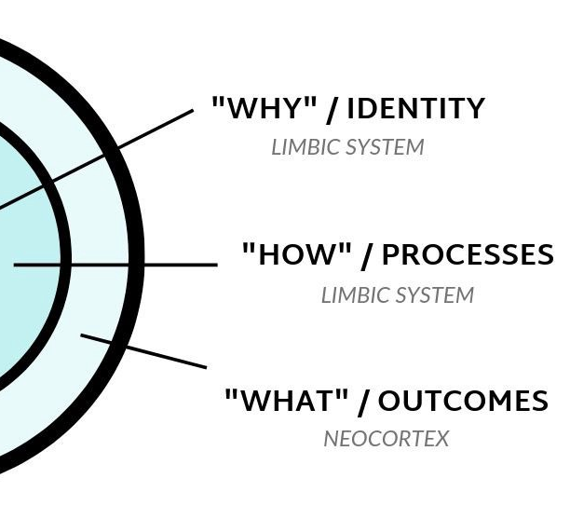
THREE LAYERS OF BEHAVIOR CHANGE
1. Outcomes: This level is concerned with changing your results. Most of the goals you set are associated with this level of change.
2. Changing Process: This level is concerned with changing your habits and systems. Most of the habits you build are associated with this level.
3. Changing your identity. This level is concerned with changing your beliefs. Most of the beliefs, assumptions, and biases you hold are associated with this level.

Slide 6
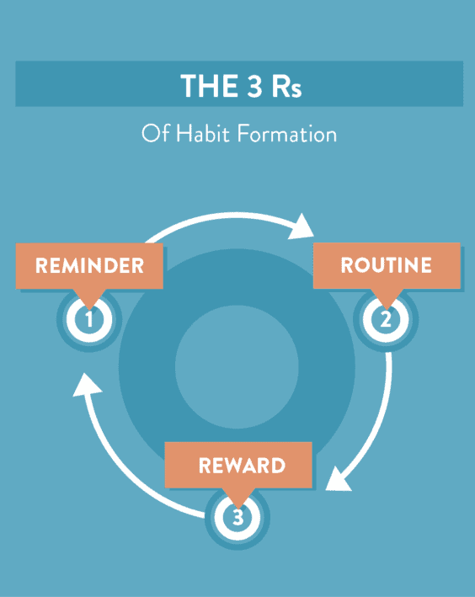
The 3 R's of Habit Change
There is a simple 3–step pattern that every habit follows. I call this pattern the
“3 R's of Habit Change” and it goes like this...
Reminder (the trigger that initiates the behaviour): Your phone rings (reminder).
Routine (the behaviour itself; the action you take): You answer your phone (routine).
Reward (the benefit you gain from doing the behaviour): You find out who is calling (reward).

Slide 7

True behaviour change is identity change.
The goal is not to read a book, the goal is to become a reader.
The goal is not to run a marathon, the goal is to become a runner.
The goal is not to learn an instrument, the goal is to become a musician.
Clip

Slide 8

Try A HABIT
Examples of identity based habits: Identity: I want to be a healthy person.
Small wins: On day one of my habit I will go for a 5 minute walk. Then I will add one minute to my walk every day after that.
✍️ Try now:
Habit Score Card- Pointing and Calling

Slide 9
6 Habits to excel at ROboSOFT
Time | Arrive 10 mins before necessary, complete a task before the deadline
Network | Know people, talk to them and make the right friends
Time out | Make the best out of breaks choose to make them screen off time and breath
Document | Get everything in writing, write everything. Set the records of work straight
Ethics | Avoid indulging in gossip, flirting and building an extremely casual personality
80/20 Rule | The key to following the 80 20 rule is to identify that roughly 20 percent of your actions or most productive tasks lead to the most success

